Slide 1
Series and parallel connection - Resistor

Slide 2
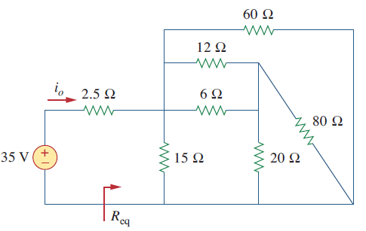
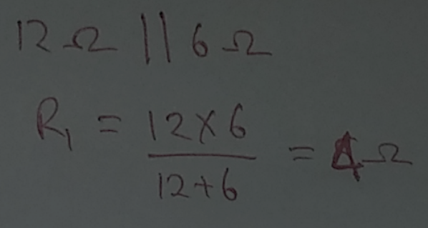
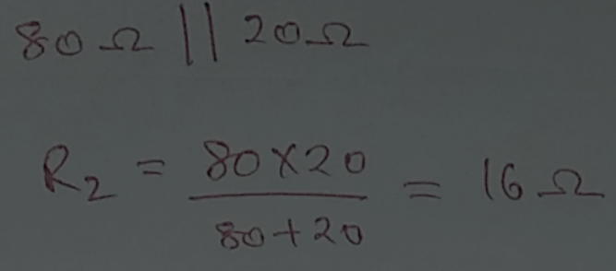
Determine R equivalent of the given circuit
Lecture 7A

Slide 3
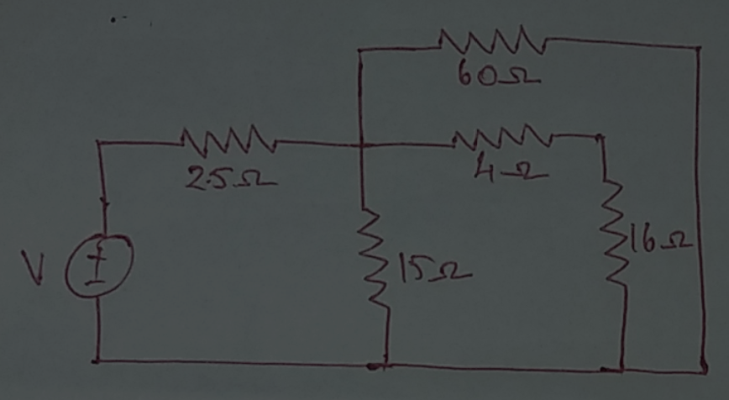
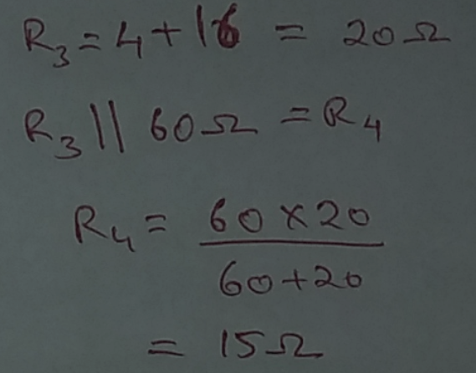
Lecture 7A

Slide 4
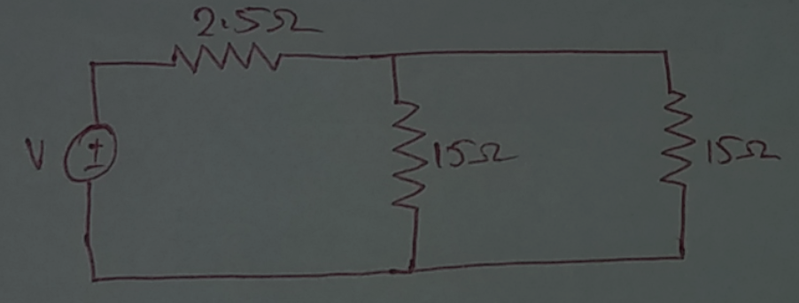
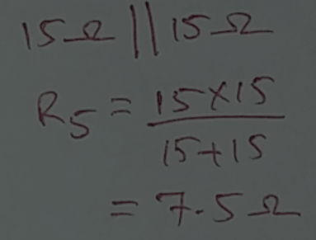
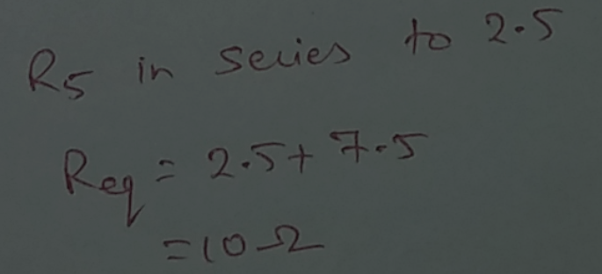
Lecture 7A

Slide 5
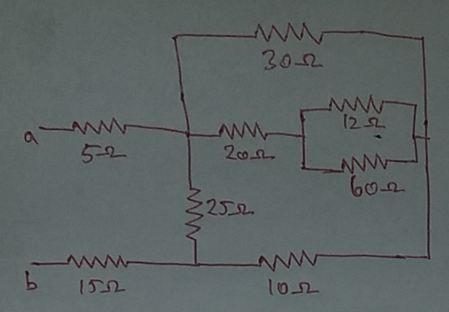
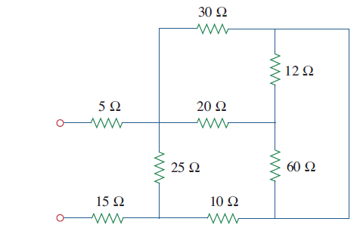
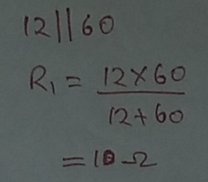

Determine R equivalent of the given circuit
Lecture 7A

Slide 6
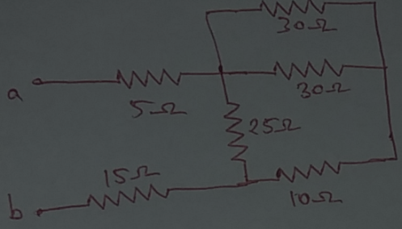
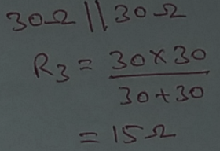

Lecture 7A

Slide 7
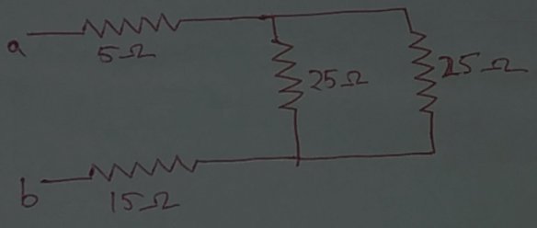
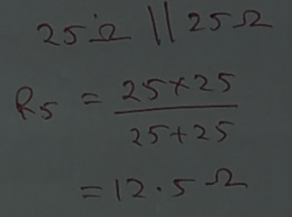

Lecture 7A

Slide 8
Reference
Edward Hughes. “Electrical and Electronic Technology”, 10th Edition, Pearson Education Asia, 2019
Alexander and Sadiku. “Fundamental of electric circuits”, McGraw-Hill, Fifth editon
Lecture 7A

Slide 9
Thank You
Lecture 7A

